Slide 1
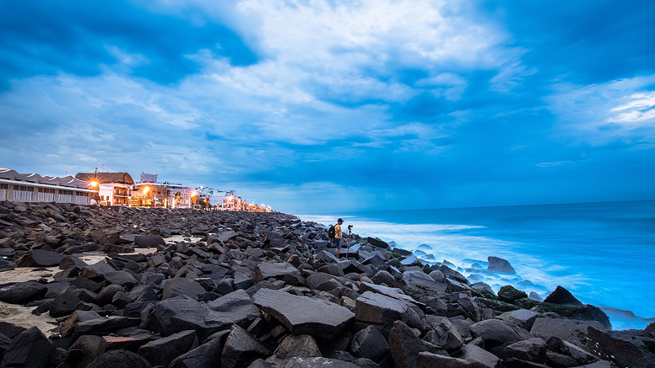
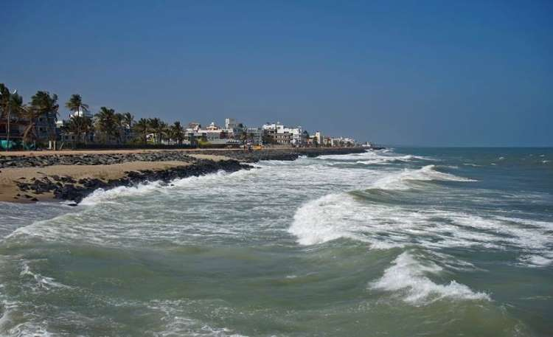
SPATIO-TEMPORAL SHORELINE PREDICITION AND VULNERABILITY ASSESSMENT ALONG THE PARTS OF COROMONDAL COAST, INDIA
Ms. MIRA SHIVANI S and Dr. N N Salghuna
Geological Technology and Geo-Informatics
^{Bharathidasan University}
Tiruchirappalli, Tamil Nadu, India

Slide 2
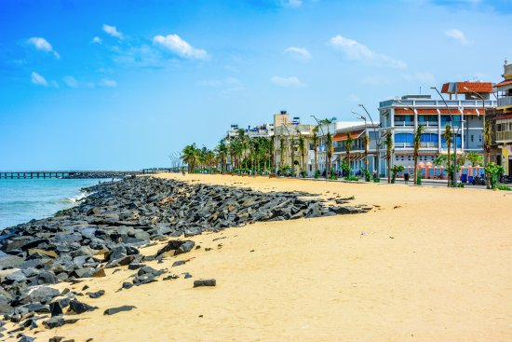
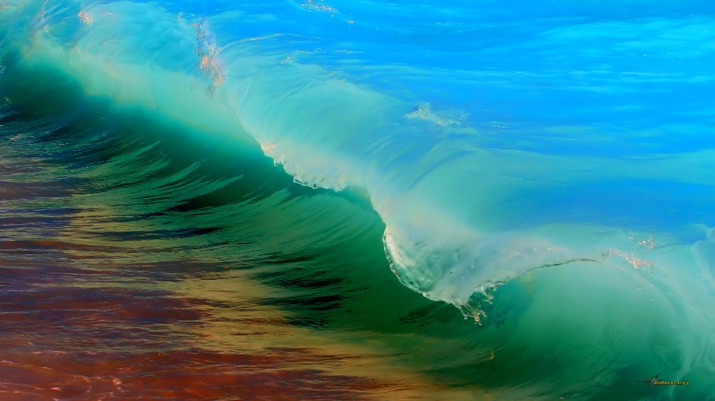
INTRODUCTION
The shoreline is a quite narrow, linear in extent and always in contact with the estuarine waterbody or Sea.
Monitoring the changes will help us to identify the root cause, human impacts and to generate measures that has to be taken to prevent further impacts.
Remote sensing data could be used to monitor the shoreline changes along the coastal zone.

Slide 3
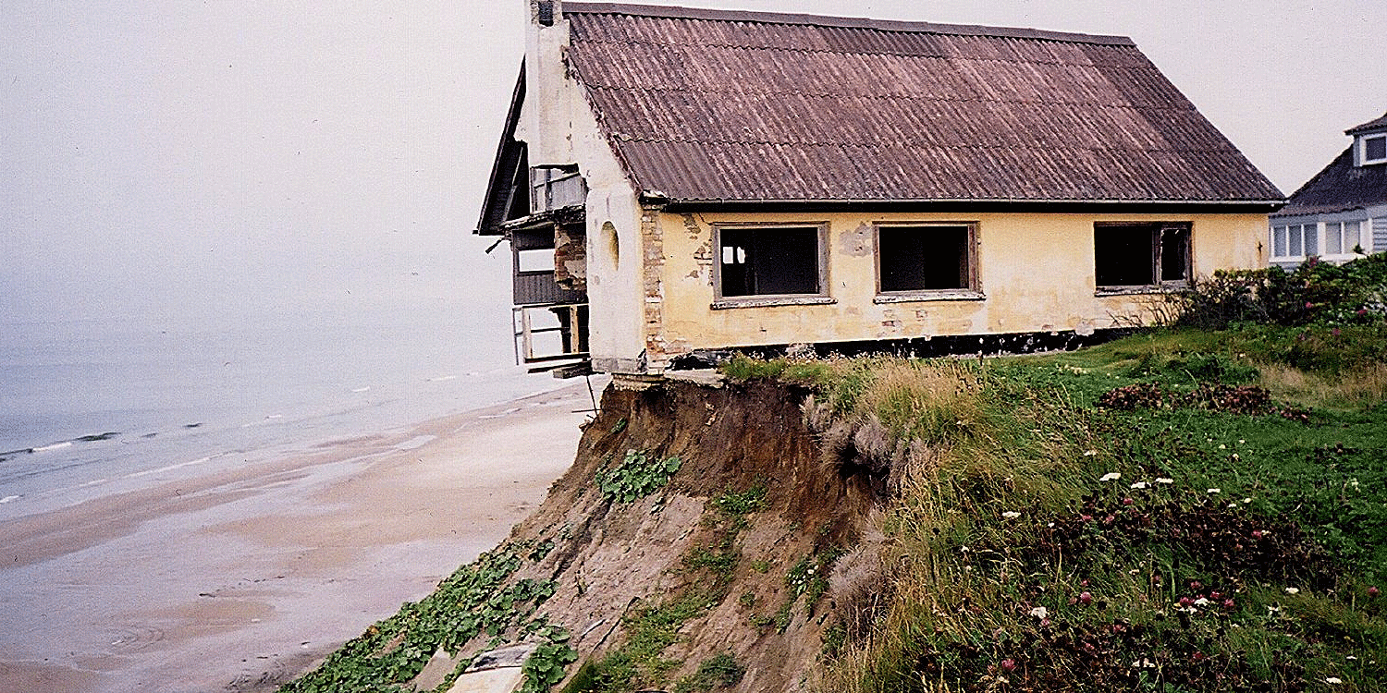
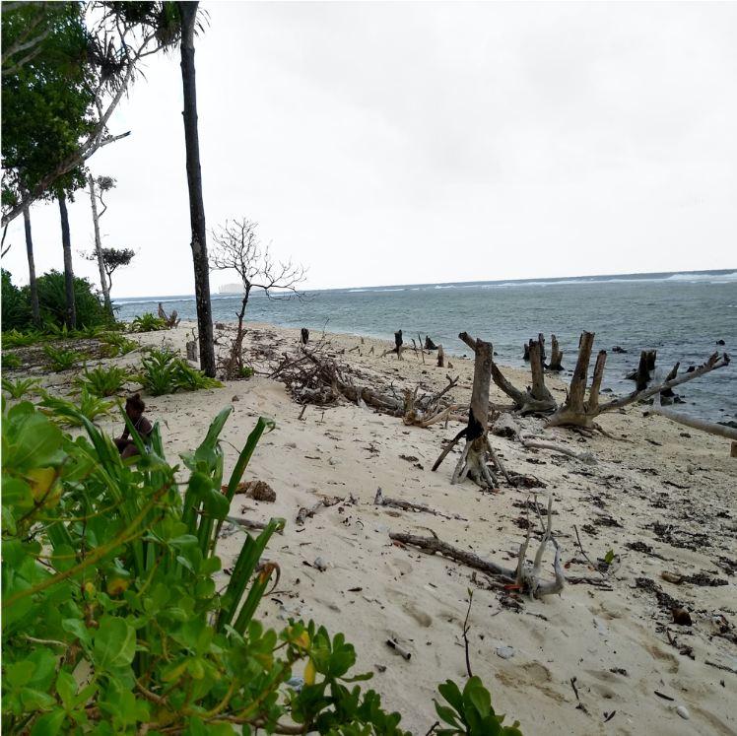
PURPOSE
The aim of the study is to predict the shoreline and assess the Vulnerability for the area.
Also, Coastal zones are extremely dynamic in nature, so understanding the cause would be a great opportunity to take measures and prevent future Disasters.

Slide 4
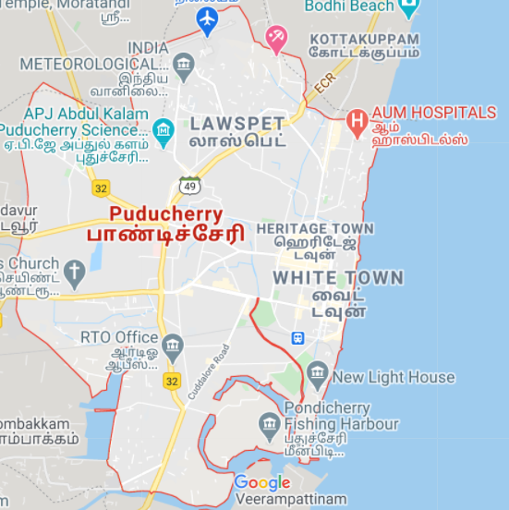
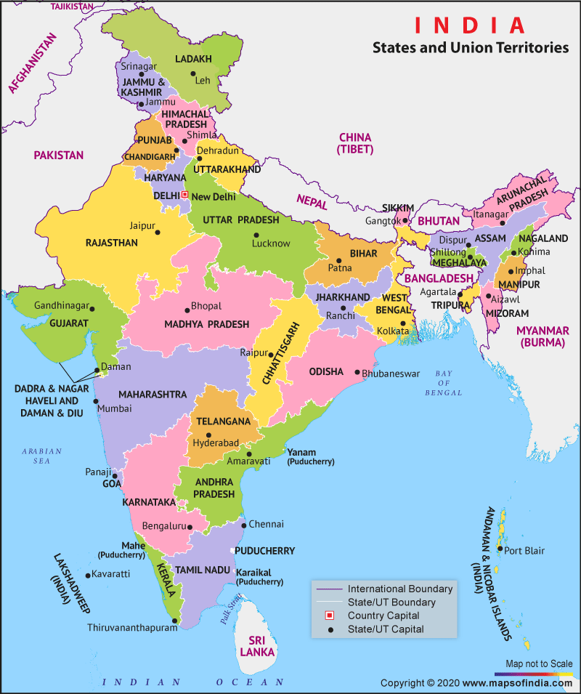
STUDY AREA

Slide 5
METHODOLOGY
LANDSAT-5 TM DATA (1990)
LANDSAT -8 OLI DATA (2020)
SOI TOPOSHEET (1972)
SHORELINE DIGITIZATION
TRANSECTS FOR 1 KM
DETERMINING COASTAL VULNERBILITY PARAMETERS USING SRTM DATA AND COLLATERAL SOURCES, COMPUTATION OF CVI
CALCULATING EROSION/ACCRETION VALUES
RANKING CVI
OPEN SHEETS
CVI MAP
PREDICTION

Slide 6
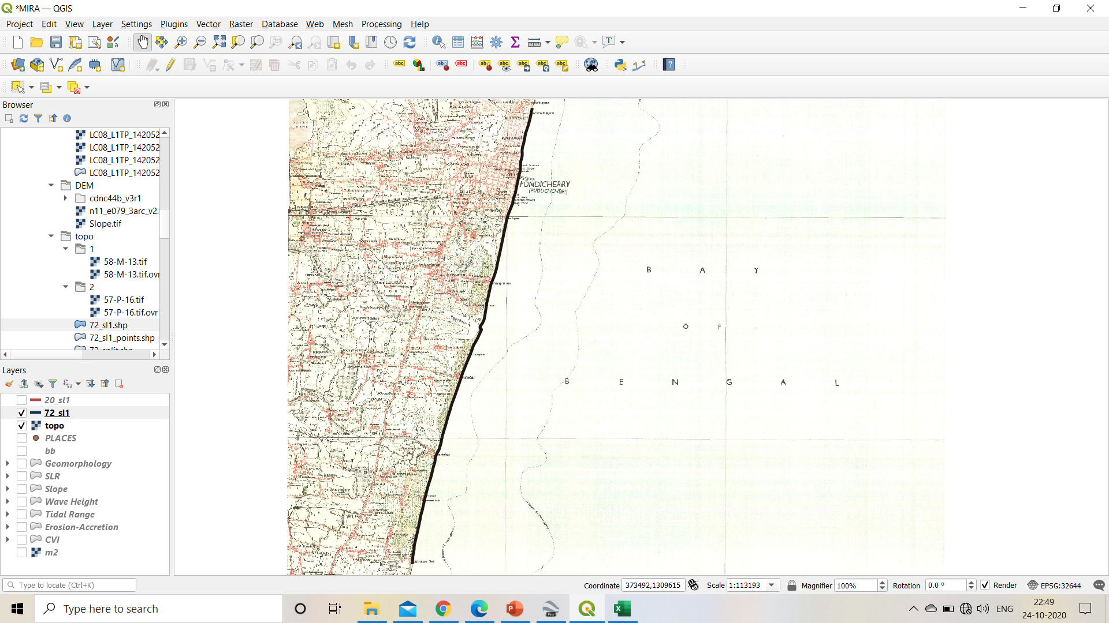
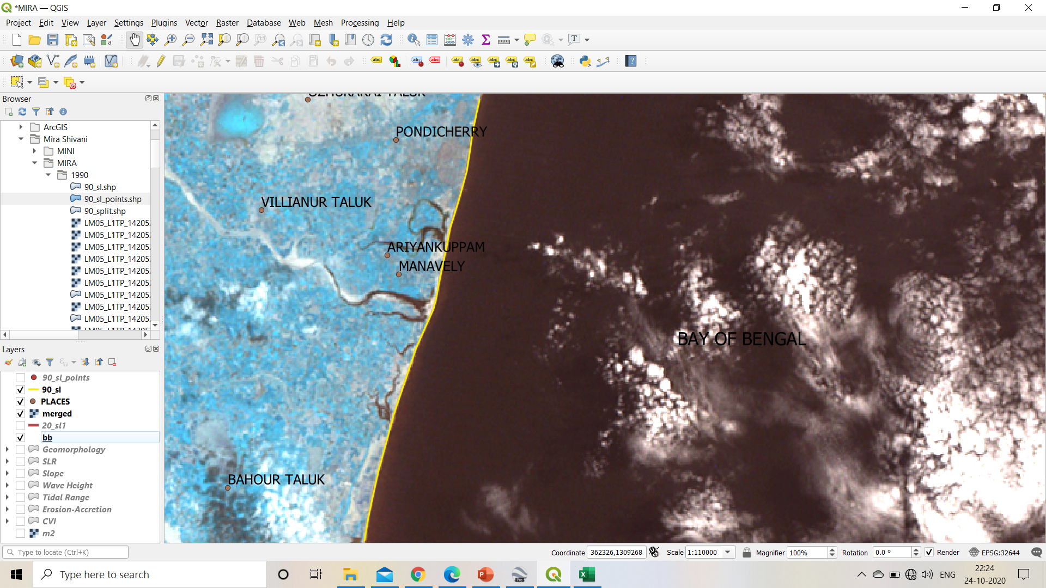
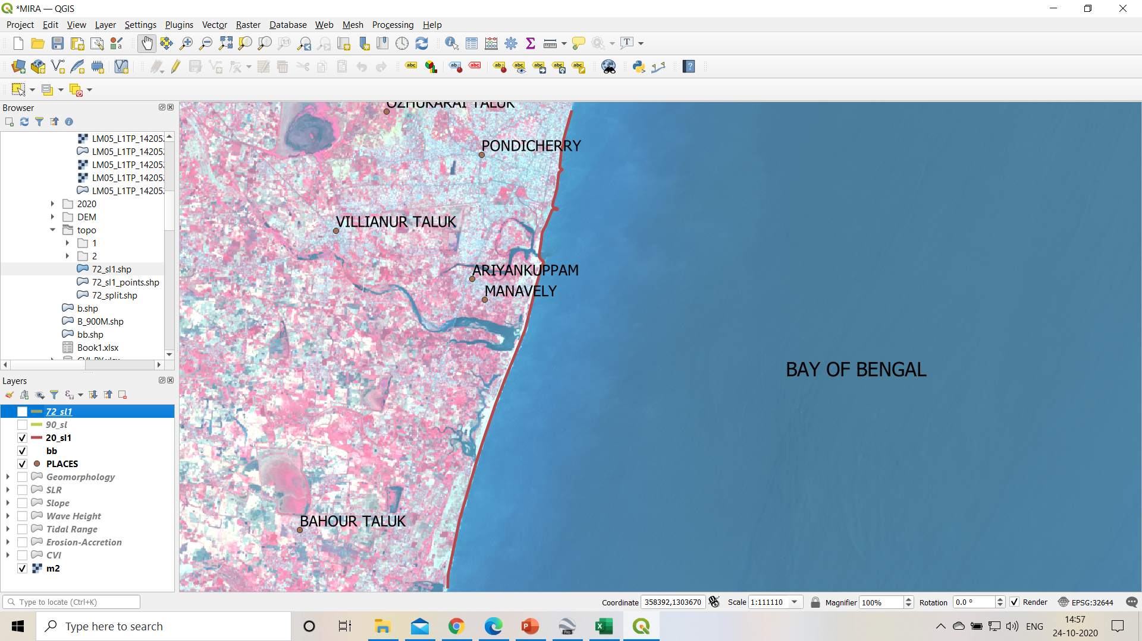
DIGITIZED SHORELINE
1972
1990
2020

Slide 7
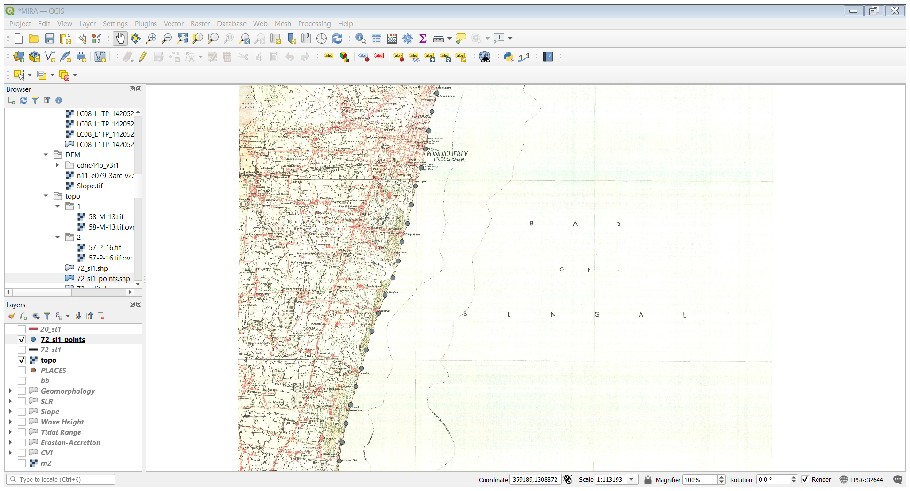
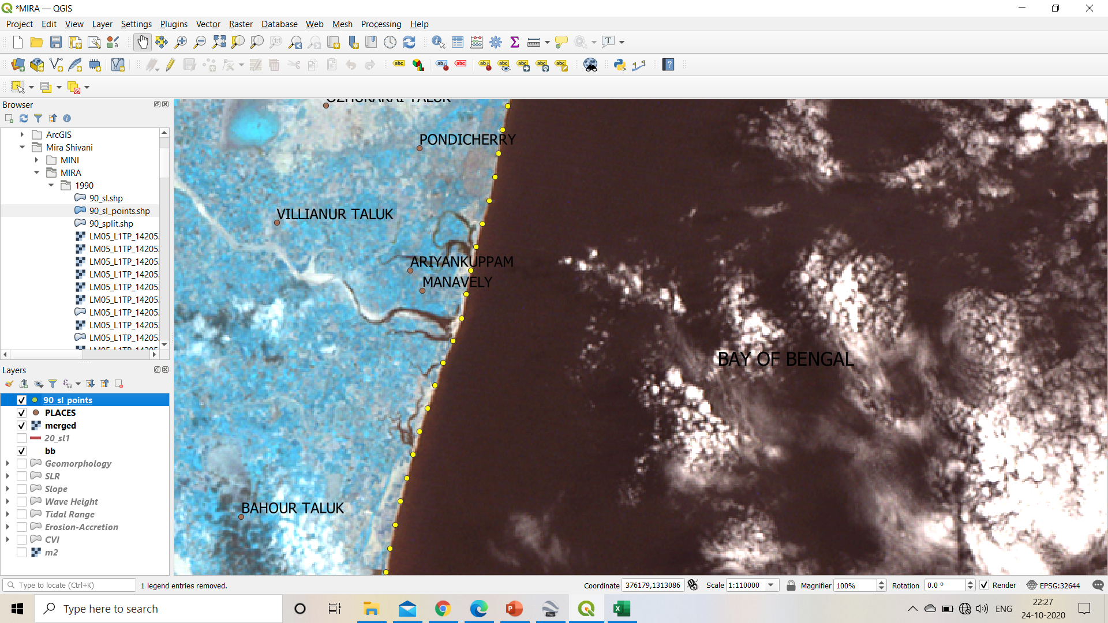
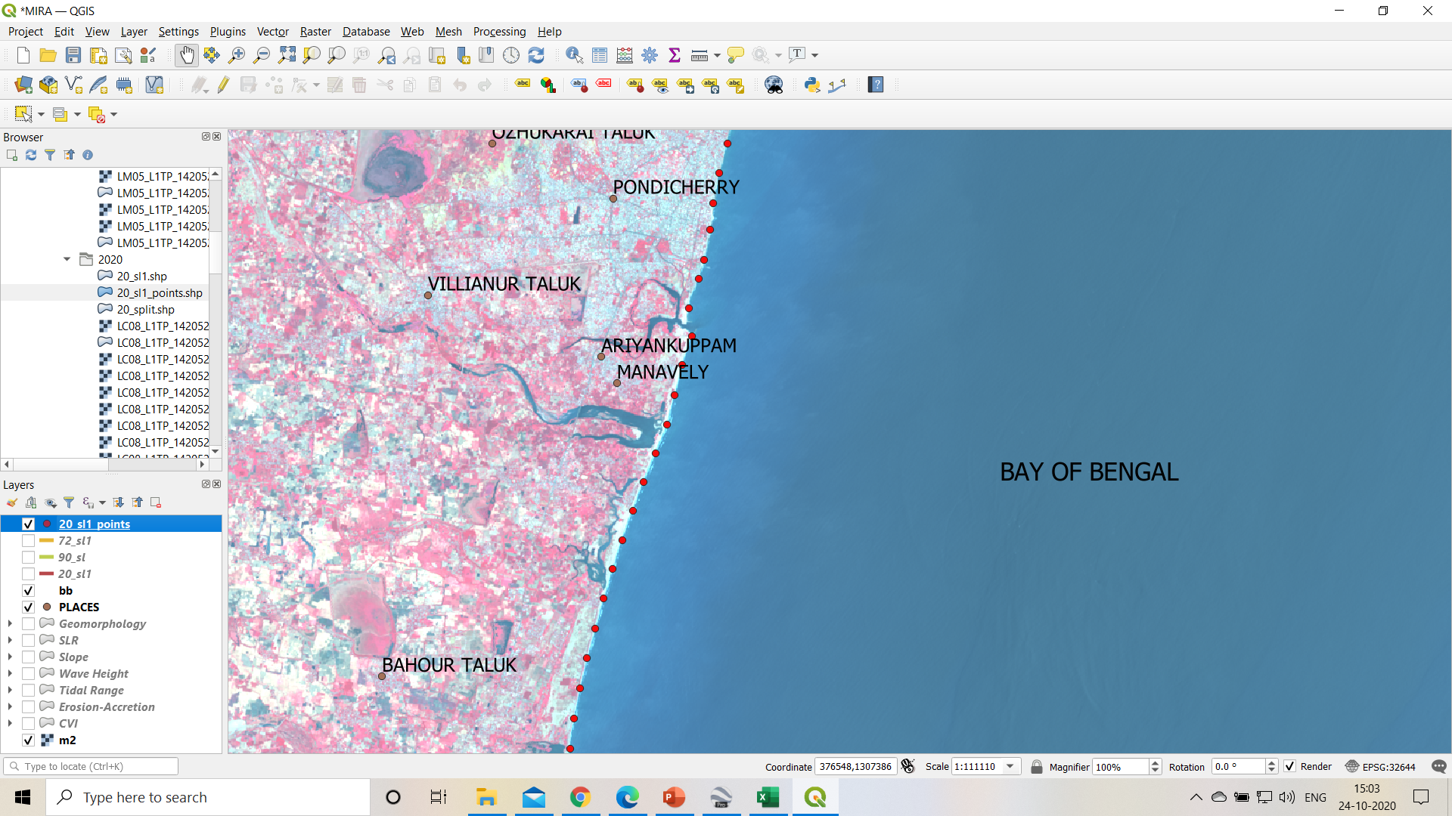
CREATING TRANSECTS
1972
1990
2020

Slide 8
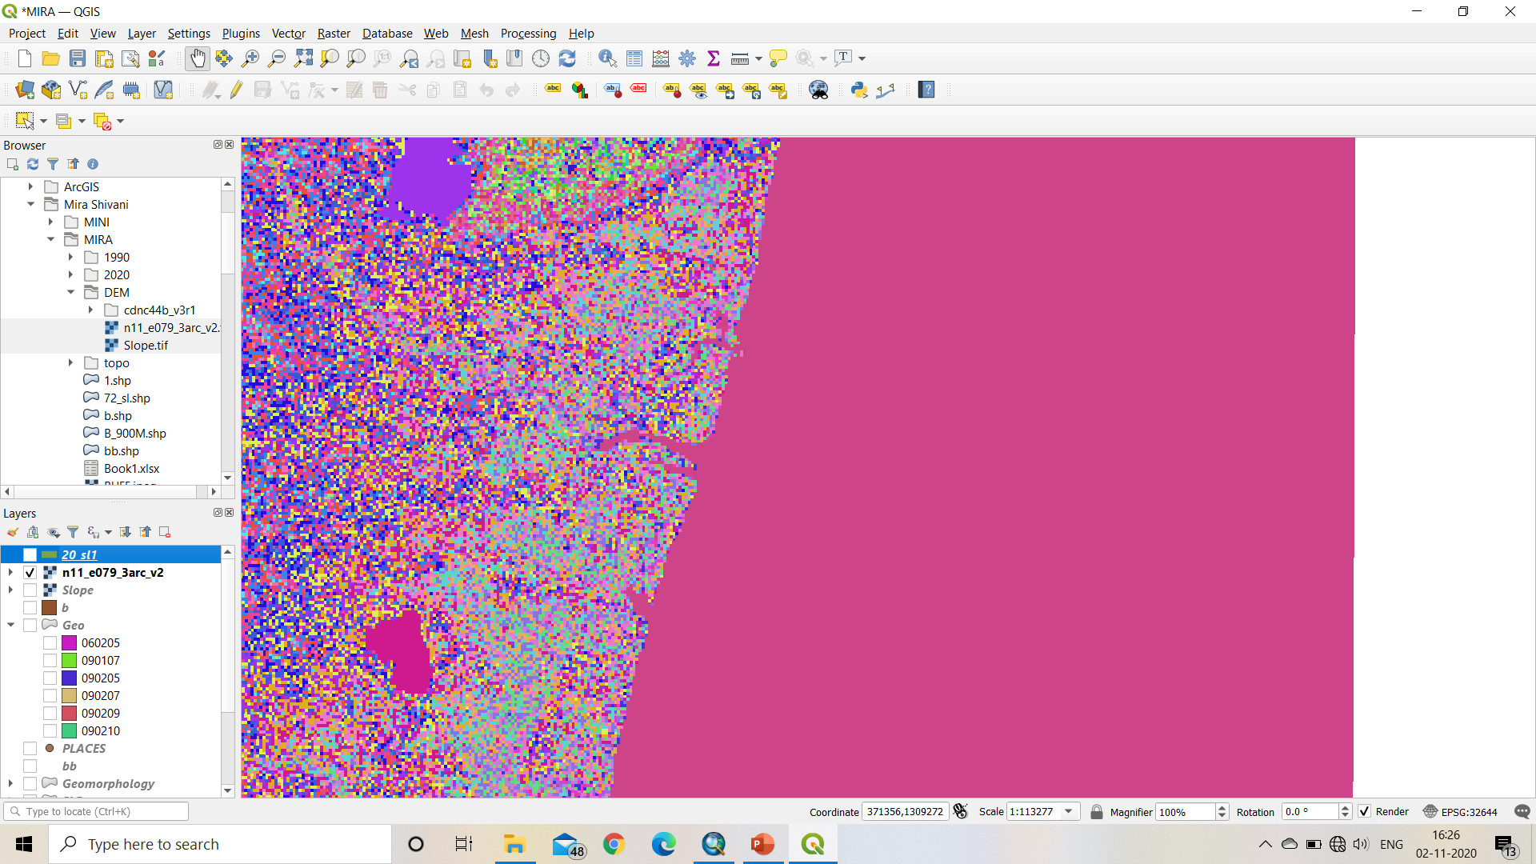
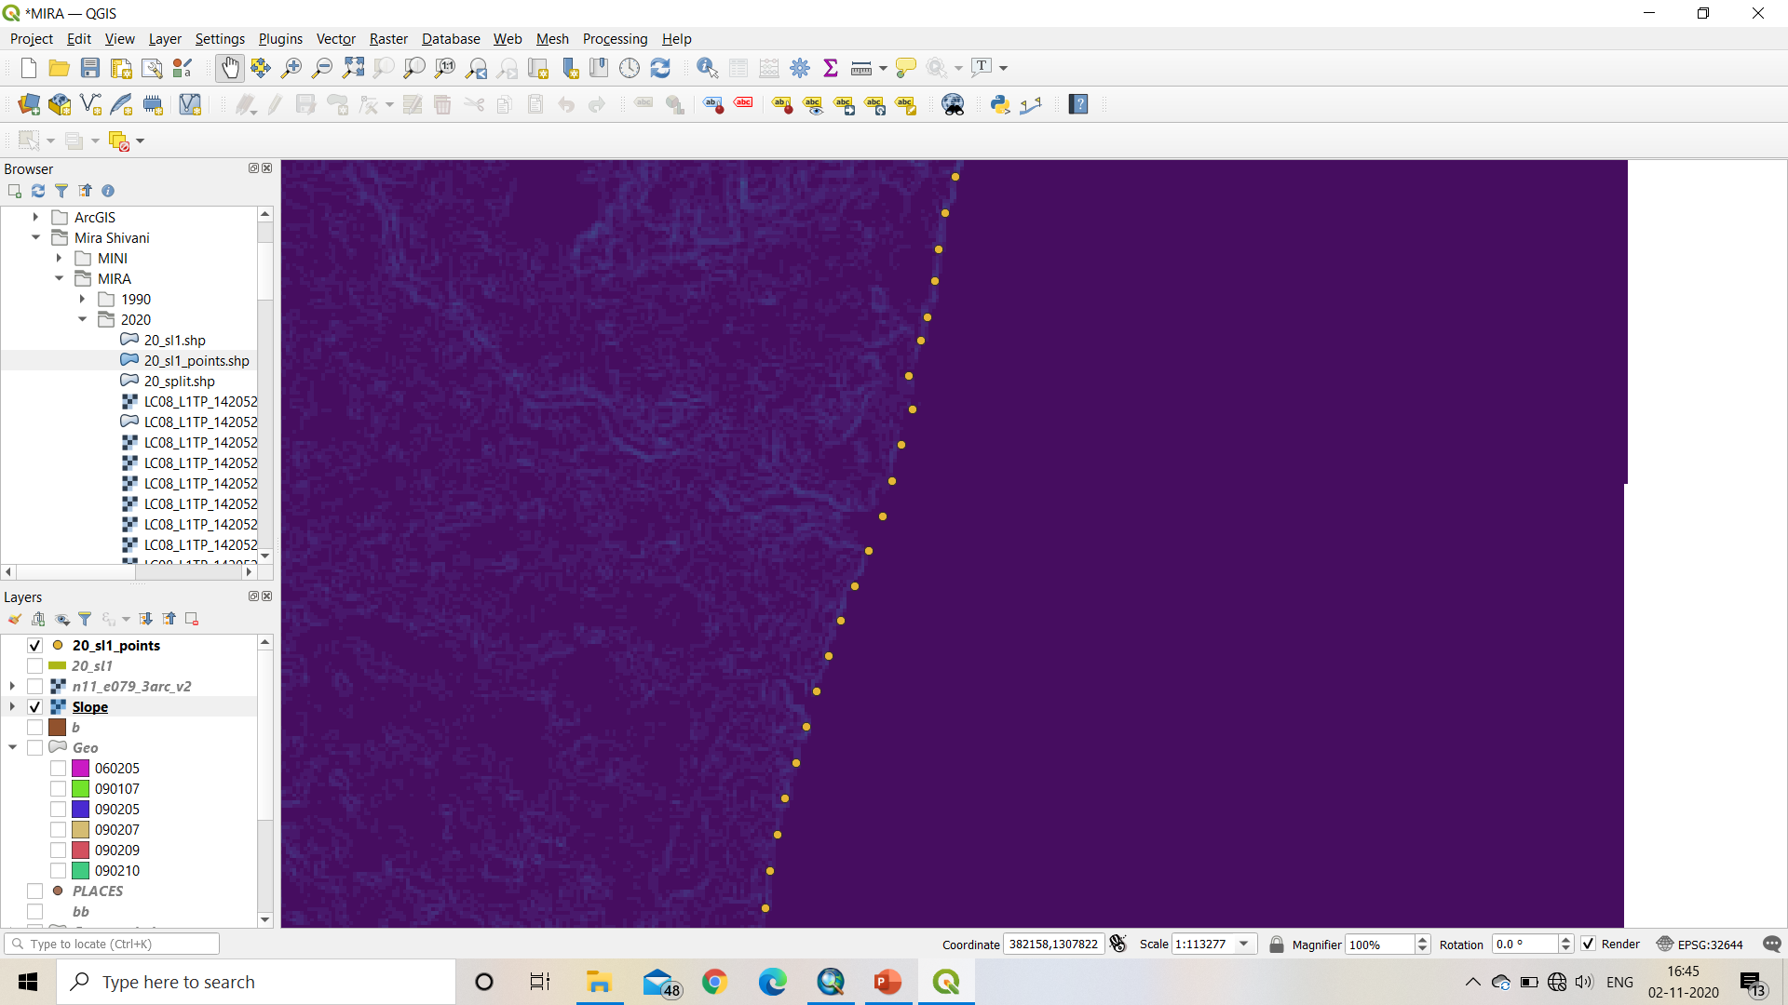
SLOPE
DEM (SRTM DATA)

Slide 9
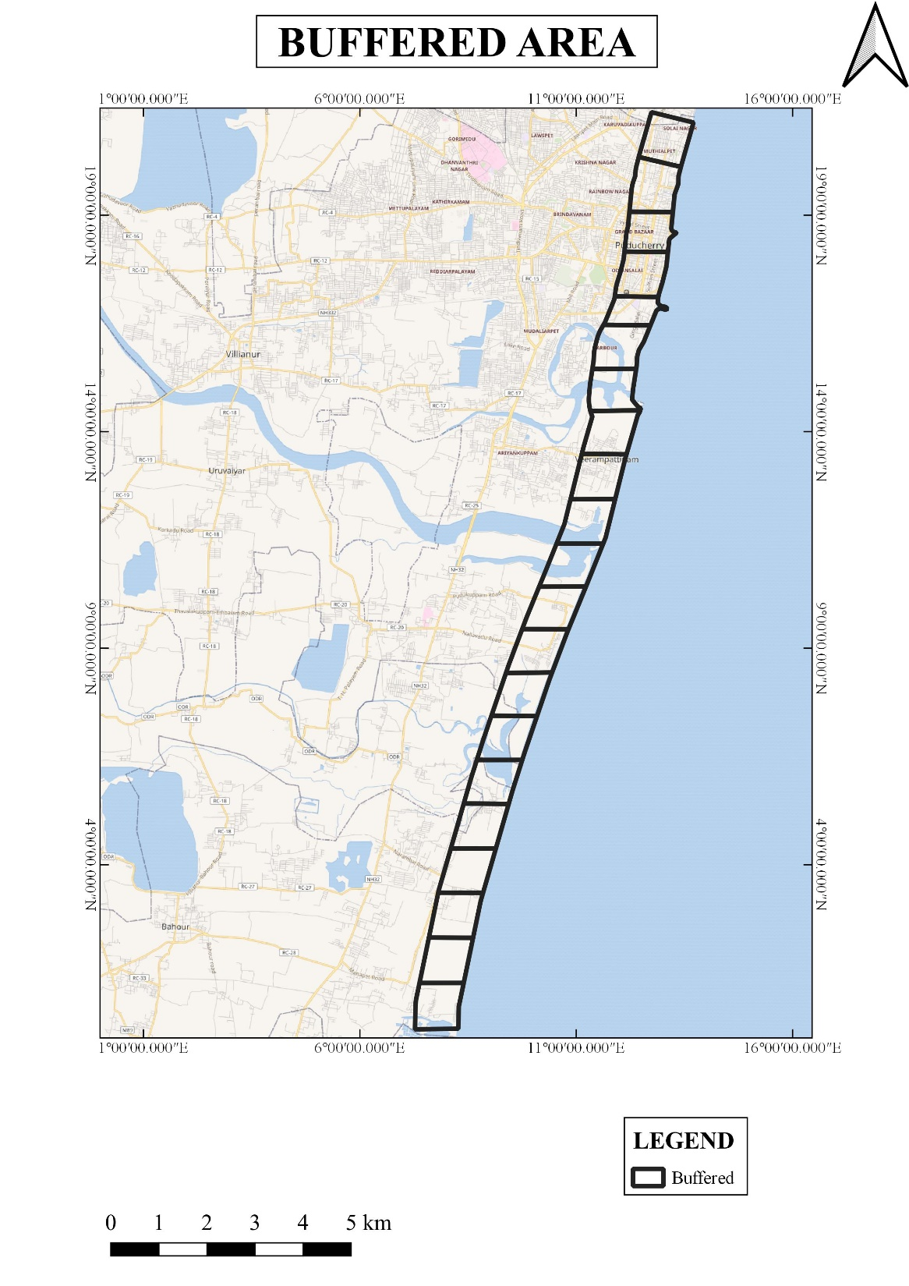
BUFFERED FOR 900 Meters

Slide 10
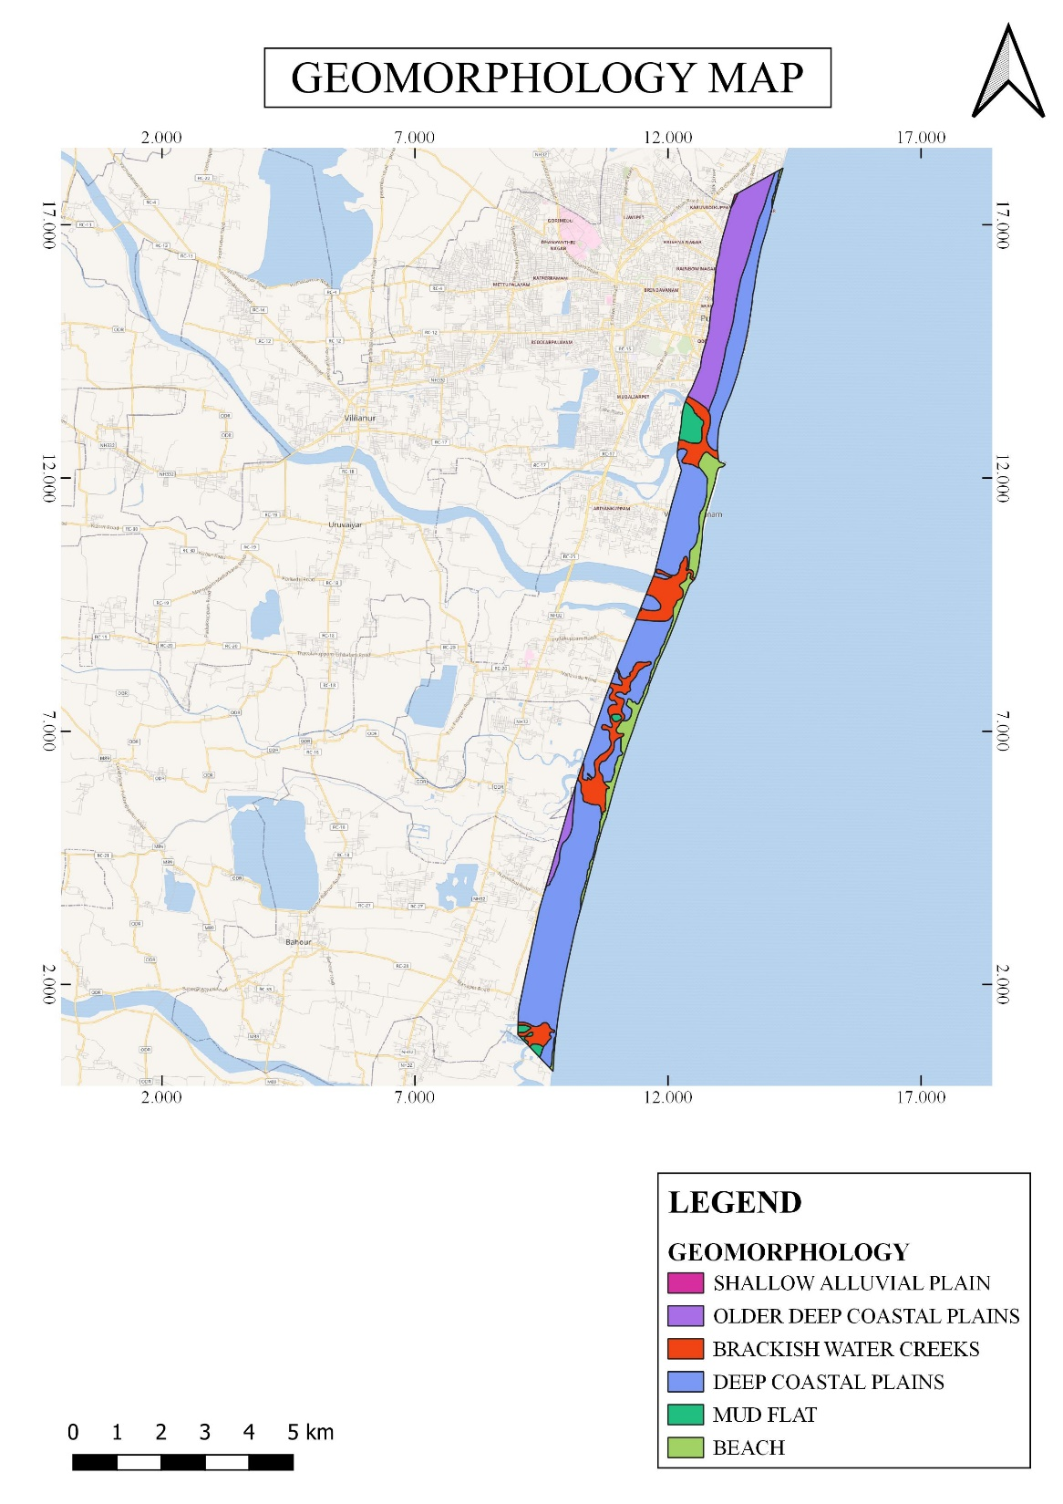
GEOMORPHOLOGY

Slide 11
SEA LEVEL RISE | CVI VALUE
0.987 Meters | 4
SLOPE | CVI VALUE
0 | 1
0-1 | 2
1-2 | 3
2-2.5 | 4
2.5-3 | 5
GEOMORPHOLOGY | CVI VALUE
COASTAL PLAIN DEEP | 4
BEACH | 2
MEAN TIDAL RANGE | CVI VALUE
2.3 Meters | 4
MEAN WAVE HEIGHT | CVI VALUE
3.26 Meters | 4
RANKING CVI
CVI | LEVEL | VALUE
16 - 18 | Very Low (VL) | 1
19 - 21 | Low (L) | 2
22 - 24 | Moderate (M) | 3
25 - 27 | High (H) | 4
28 - 30 | Very High (VH) | 5
EROSION/ACCRETION | CVI VALUE
>1 | 1
0-(-75) | 2
-75-(-100) | 3
-100-(-160) | 4
>-160 | 5

Slide 12
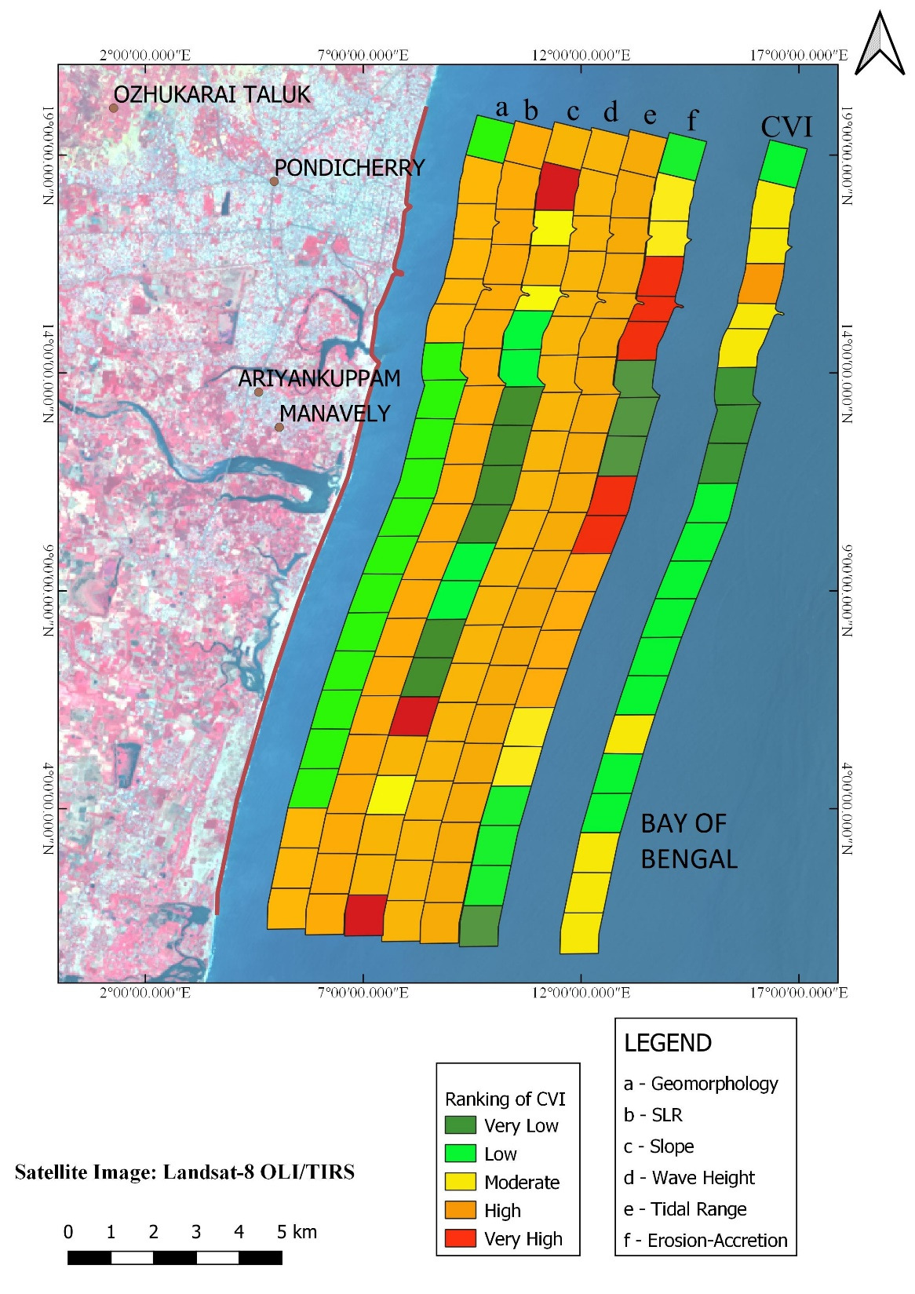
CVI MAP

Slide 13
S.NO | 1972-1990 | 1990-2020
0 | -168.71 | -14.22
1 | -122.82 | -78.55
2 | -132.94 | -91.87
3 | -112.98 | -193.92
4 | -133.97 | -199.65
5 | -111.12 | -397.88
6 | -179.03 | 328.78
7 | -163.85 | 252.83
8 | -74.32 | 220.65
9 | -91.61 | -188.93
10 | -141.89 | -171.52
11 | -135.94 | -158.79
12 | -120.95 | -142.85
13 | -103.33 | -126.77
14 | -137.87 | -110.91
15 | -160.35 | -95.56
16 | -121.79 | -81.74
17 | -114.92 | -75.42
18 | -90.22 | -61.96
19 | -91.88 | -50.49
20 | -118.35 | 7.8
- : EROSION
+ : ACCRETION
EROSION/ACCRETION VALUES

Slide 14
S.NO | 1990-2020 | 2020 - 2050
0 | -14.22 | -3.618
1 | -78.55 | -7.464
2 | -91.87 | -14.263
3 | -193.92 | -274.860
4 | -199.65 | -265.330
5 | -397.88 | -684.640
6 | 328.78 | 507.810
7 | 252.83 | 416.680
8 | 220.65 | 294.970
9 | -188.93 | -286.250
10 | -171.52 | -201.150
11 | -158.79 | -181.640
12 | -142.85 | -164.750
13 | -126.77 | -150.210
14 | -110.91 | -83.950
15 | -95.56 | -30.770
16 | -81.74 | -41.690
17 | -75.42 | -35.920
18 | -61.96 | -33.700
19 | -50.49 | -41.390
20 | 7.8 | 9.959

Slide 15
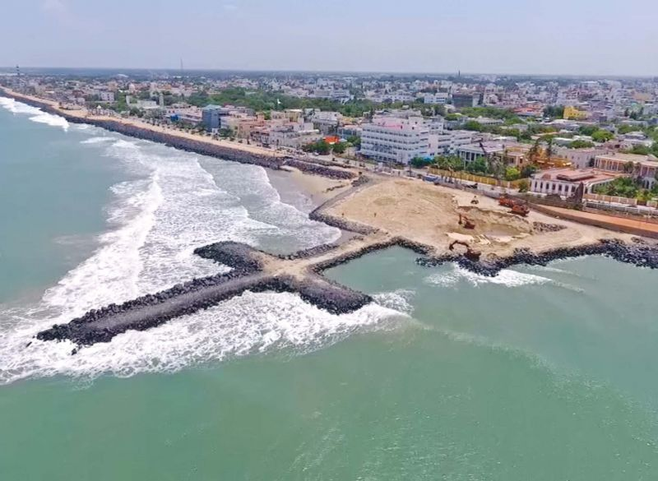
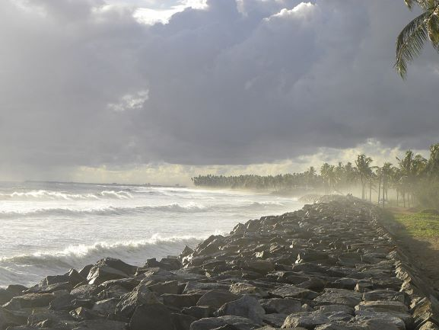
RESULTS AND CONCLUSION
With the prediction done for the Puducherry Coast, it is evident that there will be more Erosion than Accretion along the coast.
Engineering structures like Groynes, Jetties, Breakwaters, Revetments can prevent the erosion along the coast.

